Slide 1
Navigating protein landscapes with a machine-learned transferable coarse-grained model
Journal Club September 10th 2025
Moritz Obenauer

Slide 2

Before we start…
Thank you for attending the journal club in the last six weeks!
Please fill out the feedback form after the talk!

Slide 3
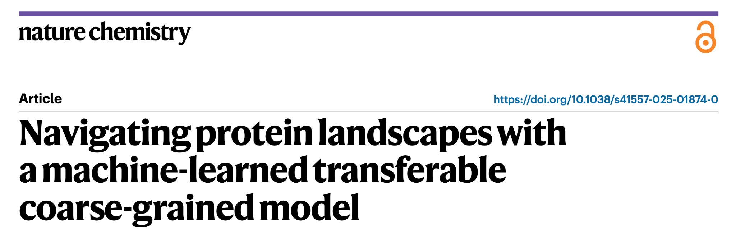
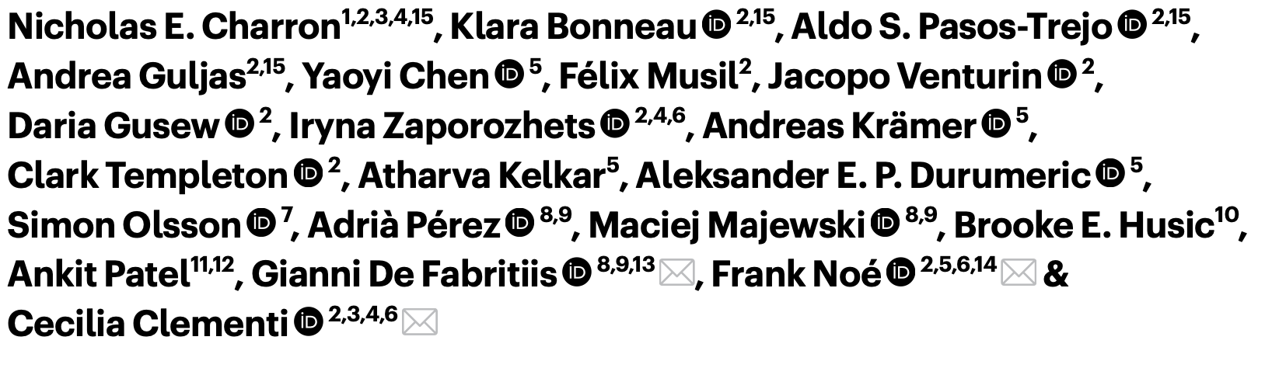
Notes:
I will go through the main talking points of the paper (maybe 20-30 minutes) and then we have plenty of time to discuss,
However, please interrupt me at any time!!

Slide 4


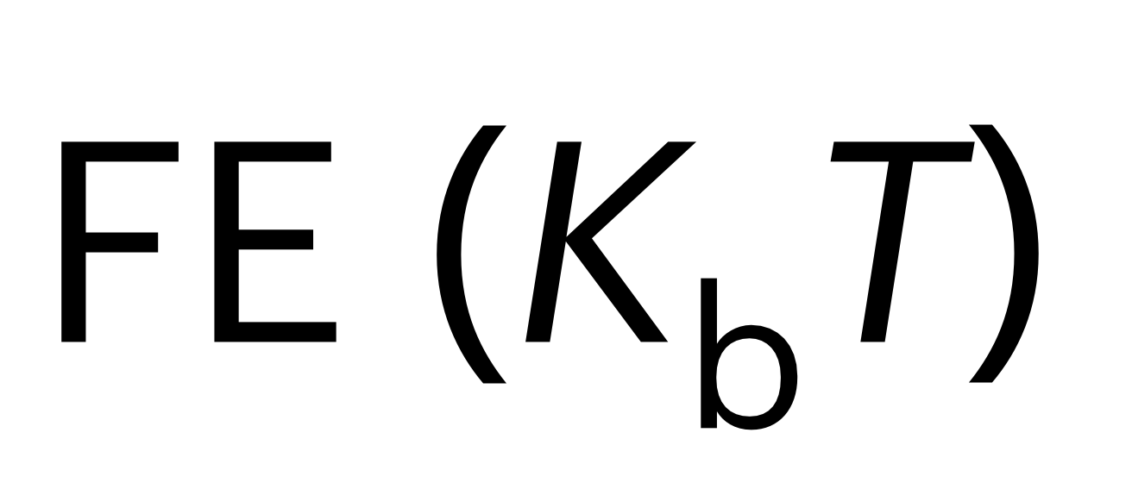

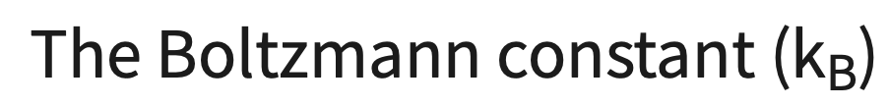


Slide 5
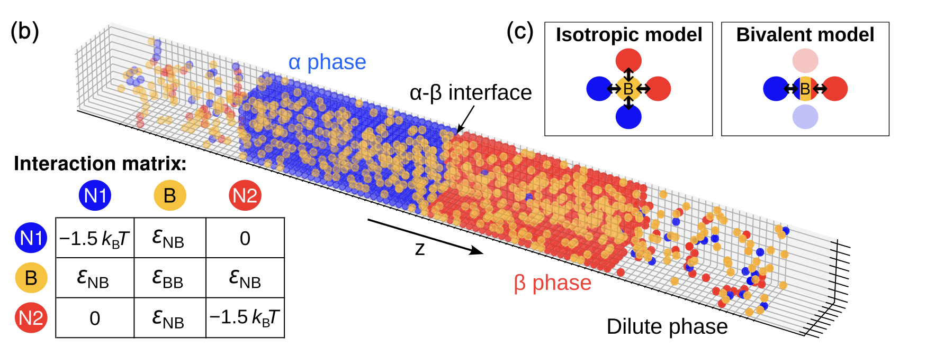
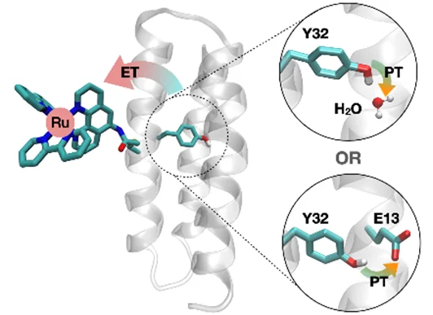


Length- and time scales of protein dynamics
“ There's Plenty of Room in Between”
- Not Richard Feynman

Slide 6
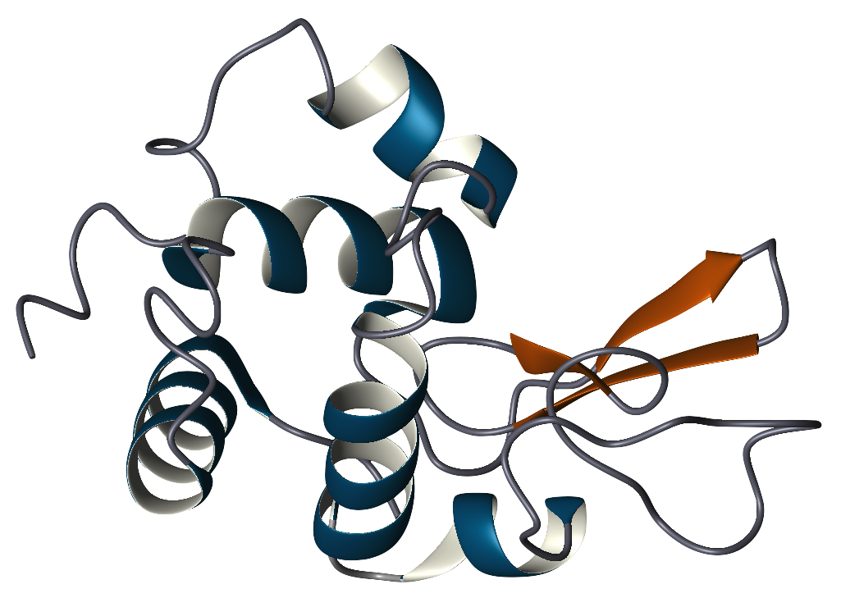
Length- and time scales of protein dynamics

Slide 7
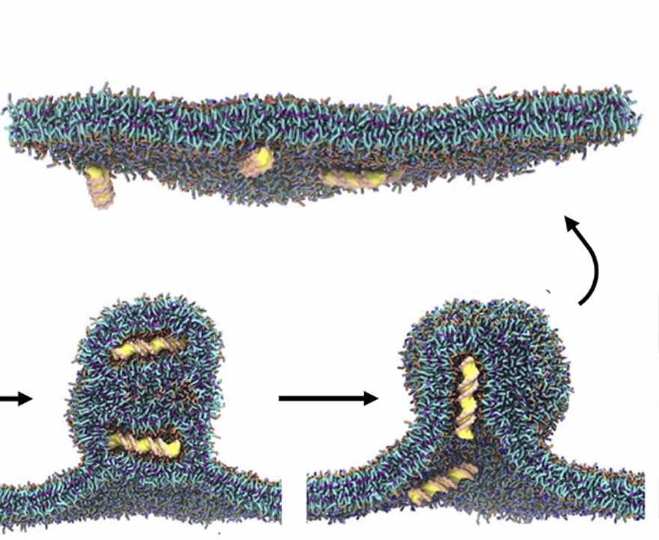
Length- and time scales of protein dynamics

Slide 8
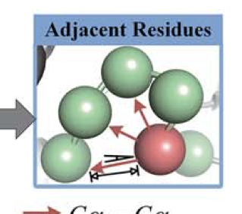
Length- and time scales of protein dynamics

Slide 9
Length- and time scales of protein dynamics
This work
Notes:
The last papers were mostly MLPs as a surrogate for DFT calculations so that we can achieve quantum accuracy with less computational effort → now we want to improve CG simulations and our reference are classical MD simulations
Ryan gava a chalk talk last year: US academia is less fond of coarse graining than the European Chemistry community, so just remember that conceptually we are doing the same thing: going from QM to actual representations in terms of single atoms is also just a form of CG!

Slide 10
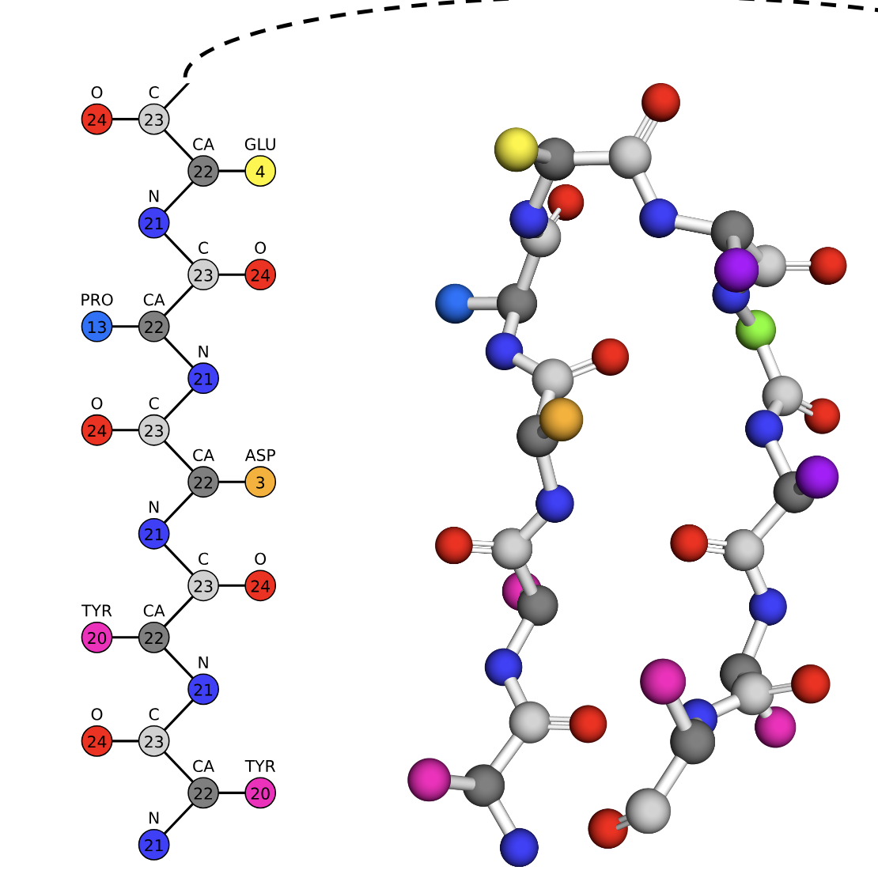
Length- and time scales of protein dynamics
Notes:
Resolution: something in between MARTINI and Go models, polypeptide backbone is modelled explicitly with atom types (- hydrogen) and then the C beta atoms are encoding the functional group!

Slide 11
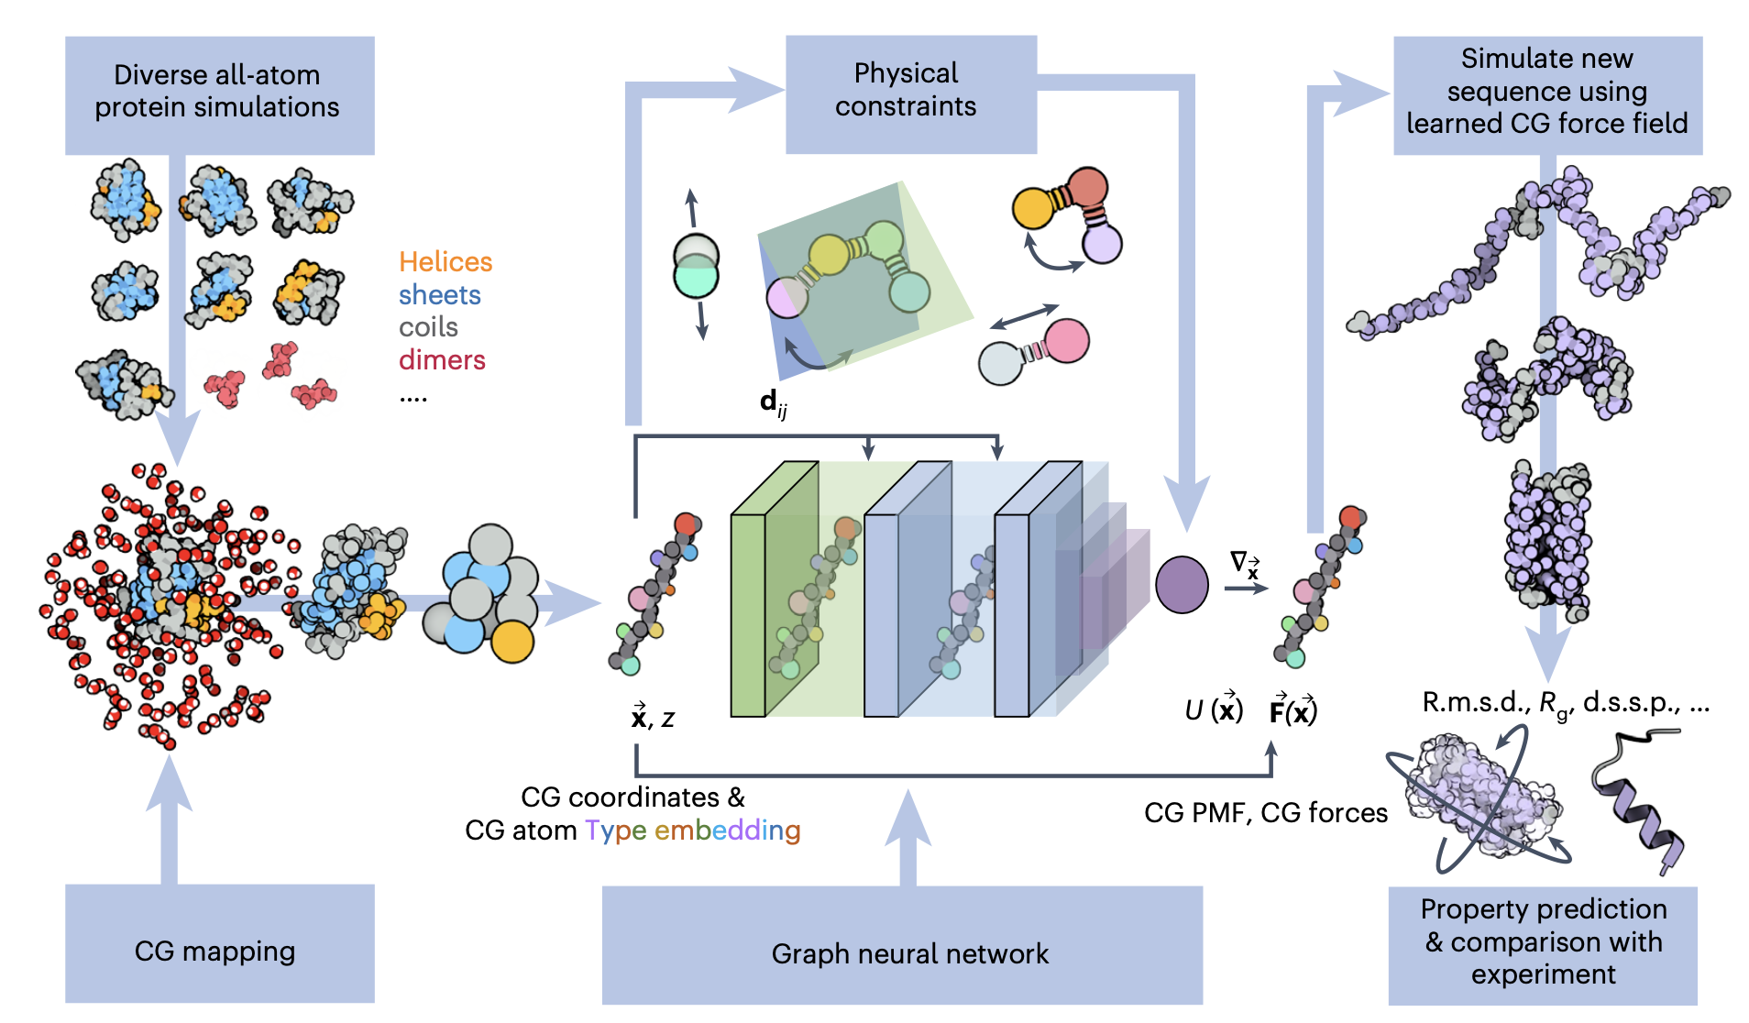
Overview of the proposed model
Notes:
Overview of the model or workflow. We will go through the different sections, starting with the training data set

Slide 12
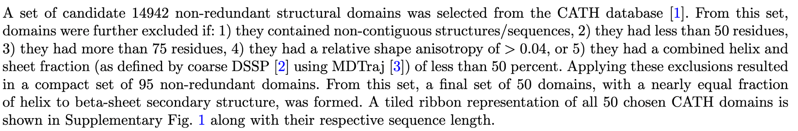
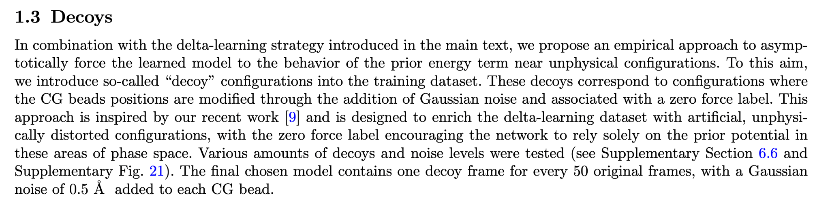
Dataset
Notes:
Relatively small and restricted data set, so only 50 peptide structures to learn from! + Dimers of mono+dipeptides!
Dimers: probably used to really learn the interactions between two similar amino acids in a “clean” environment without many multibody interactions
Decoys: interesting concept to really help to use the idea of prior energy, which we will talk about later.

Slide 13
Overview of the proposed model

Slide 14
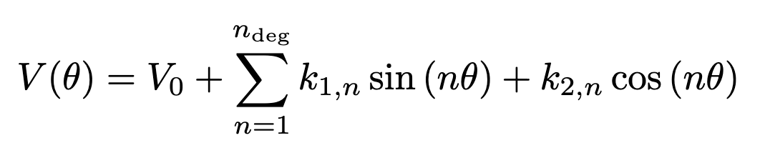
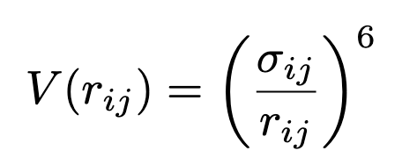
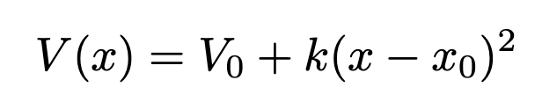
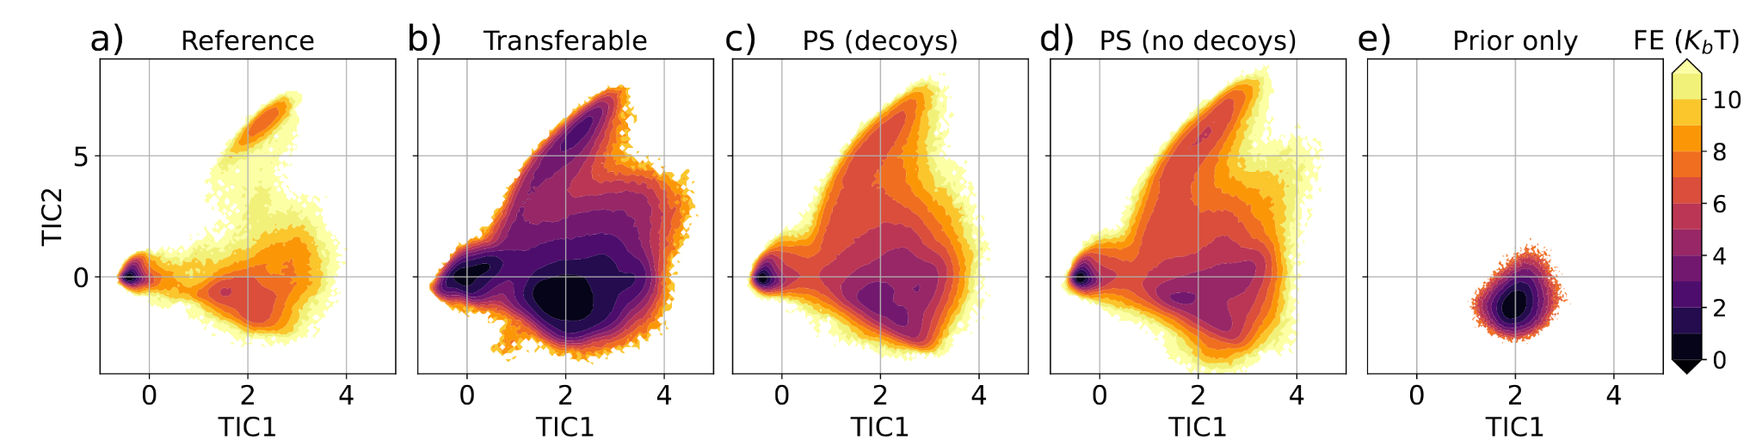
Physical Constraints: Prior Energy Terms
Notes:
Fig. 8: Performance of a single protein model of Chignolin at the same resolution of the transferable model, illustrated by
the free energy surface in the space of the first two components of a TICA analysis. a) All-atom reference, b) transferable
model shown in the main text, reproduced here for comparison purposes, c) protein-specific (PS) CGSchNet trained on
the AMBER Chignolin reference data with a prior energy and decoys, d) protein-specific CGSchNet trained with a prior
energy but without decoys, e) simulation of the prior force field only.
ONLY REPULSIVE! The k parameters are not learned they are calculated from the AMD simulations prior to the learning process. → Just helps to discourage the learning/predicting of physically unreasonable structures. Prior only simulations only explore unfolded state!

Slide 15
Overview of the proposed model

Slide 16
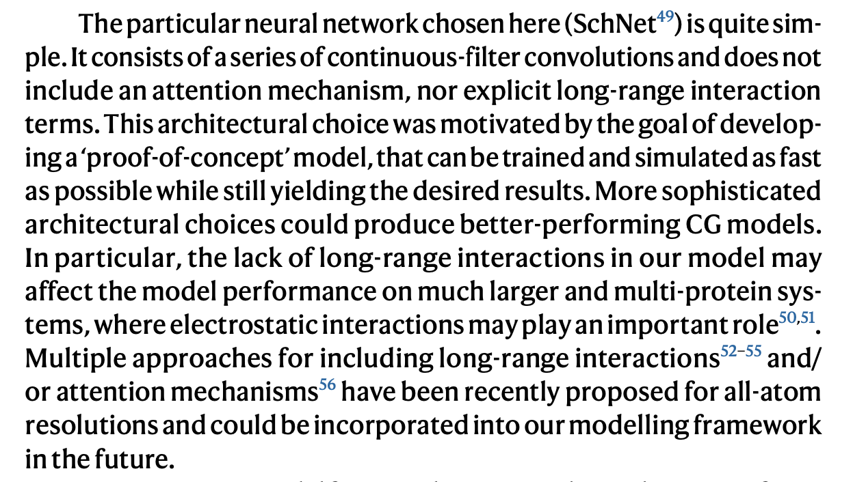
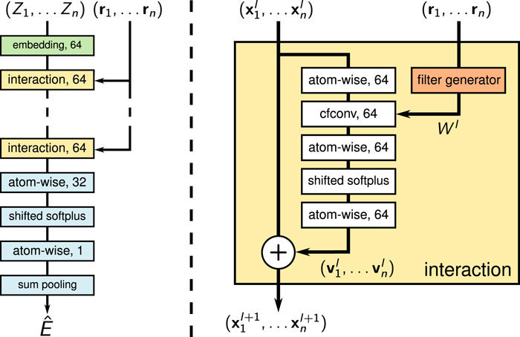
Network Architecture
Notes:
Rotational and translational invariance of the energy is enforced in SchNet so these invariances dont have to be learned!

Slide 17
Overview of the proposed model

Slide 18
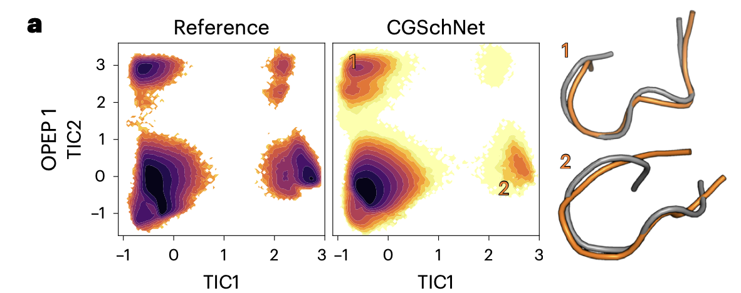
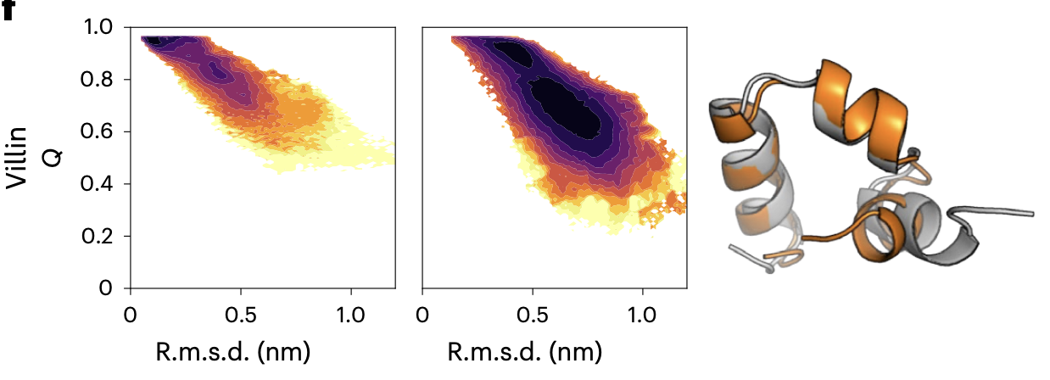
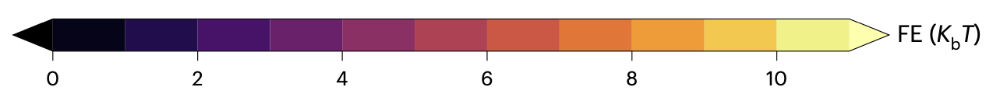
Results: Conformational Space
Notes:
Fig. 6 | Mutational study with ubiquitin. a, The resolution of the CG model allows for straightforward point mutations. b, Comparison of the ΔΔG value estimated from our model and the reference experimental ΔΔG at 298 K from ref. 41. The Pearson correlation coefficient (r = 0.63) and mean absolute error (MAE = 1.25 kcal mol−1) are also reported. The black dotted line shows y = x, and the shaded region marks the interval y = x ± 1 kcal mol−1. Error bars are estimated via bootstrapping, resampling 99 times by taking batches of 10,000 independent elements of the initial folded and unfolded ensembles for each mutation.
Question: What is the most likely conformation to encounter? (The most stable)
Two examples: random coil polypeptide and an actually folded one with alpha helices → qualitative agreement

Slide 19
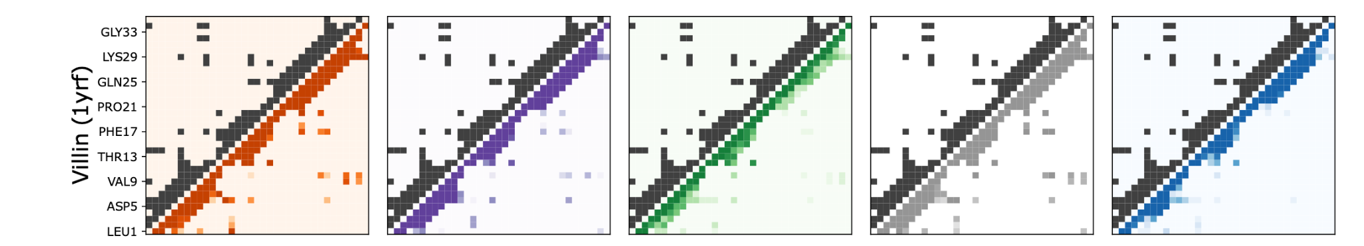
Results: Conformational Space
Notes:
Contact maps of the alpha helix folded region in Vilin

Slide 20
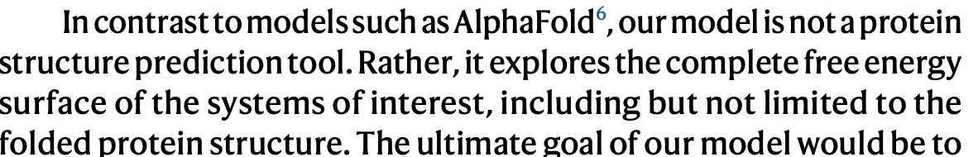
Comparison to e.g. Alpha Fold
Notes:
Alpha Fold is a diffusion model that was trained on the PDB: you give it a peptide sequence and it gives you the most likely 3D structure associated with that input sequence → no thermodynamics / dynamics in general! There is no energy or force associated with that!!!
If the folded structure is the only important thing then this is fine. In de novo protein design where you are interested in achieving a certain secondary/tertiary structure to perform a certain action!
Limitations: Folding events!

Slide 21
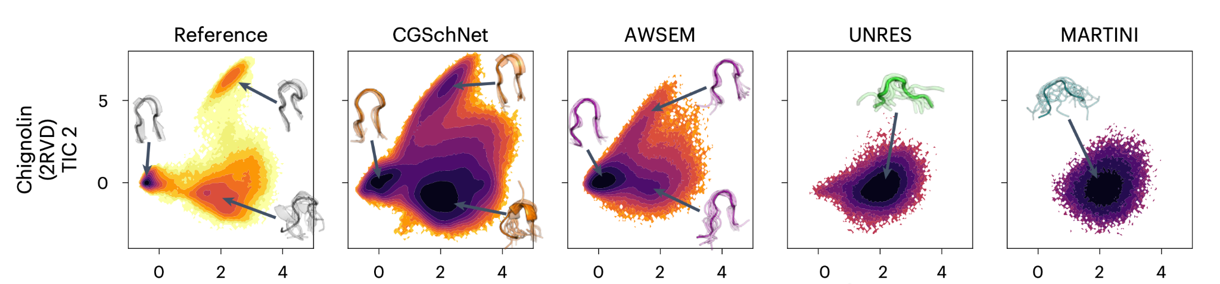
Results: Conformational Space
Notes:
It is a quality of the model to be able to predict misfolded local minima states!! Not only the ground state!

Slide 22
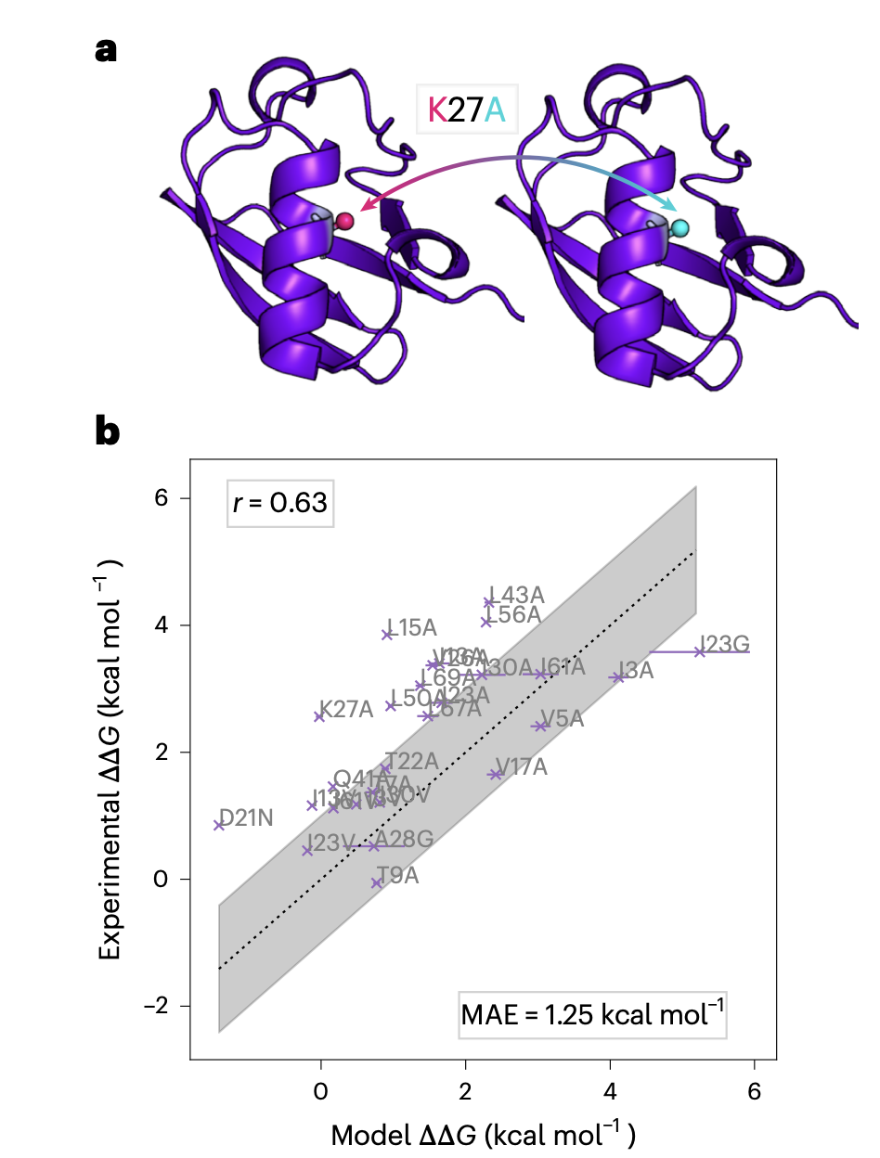
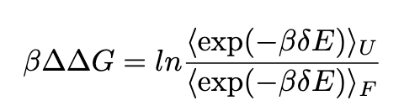
Results: Mutational Studies
Important to note: How is folded and unfolded defined?
Notes:
Michael Hecht class: generally a non-trivial thing, even atomistic models often fail to do this constantly and reliably! You have protein A and protein B and they both have a folding energy gain Delta G. This can change if you substitute an amino acid maybe because you destroy an important, stabilizing hydrogen bond etc.
Mutational studies can give insights on how important certain amino acids are in the sequence for the secondary structure!
Given that this is a CG model, the qualitative agreement with experiment is actually impressive. Problem: how do you define <E(F)> and <E(U)>
Fig. 6 | Mutational study with ubiquitin. a, The resolution of the CG model allows for straightforward point mutations. b, Comparison of the ΔΔG value estimated from our model and the reference experimental ΔΔG at 298 K from ref. 41. The Pearson correlation coefficient (r = 0.63) and mean absolute error (MAE = 1.25 kcal mol−1) are also reported. The black dotted line shows y = x, and the shaded region marks the interval y = x ± 1 kcal mol−1. Error bars are estimated via bootstrapping, resampling 99 times by taking batches of 10,000 independent elements of the initial folded and unfolded ensembles for each mutation.

Slide 23
Open Questions
🌡️ Generalizing to temperature / pressure space
➕ Electrostatic interactions (explicit LR interactions)
🔎 What is the right level of coarse-graining for applications?
Notes:
Also: non-natural amino acids, Data set did not include turns/beta hairpin structures, Tertiary structures (barrels?)
Could the mapping itself be done by a NN?

